Slide 1

Welcome to your Quest
By Agrima Sharma and Varun Nair

Slide 2
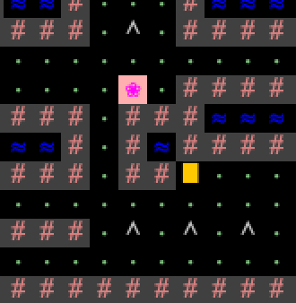
Creative Mechanics 1: Flower & Door
You must collect the flower in order to unlock the door

Slide 3
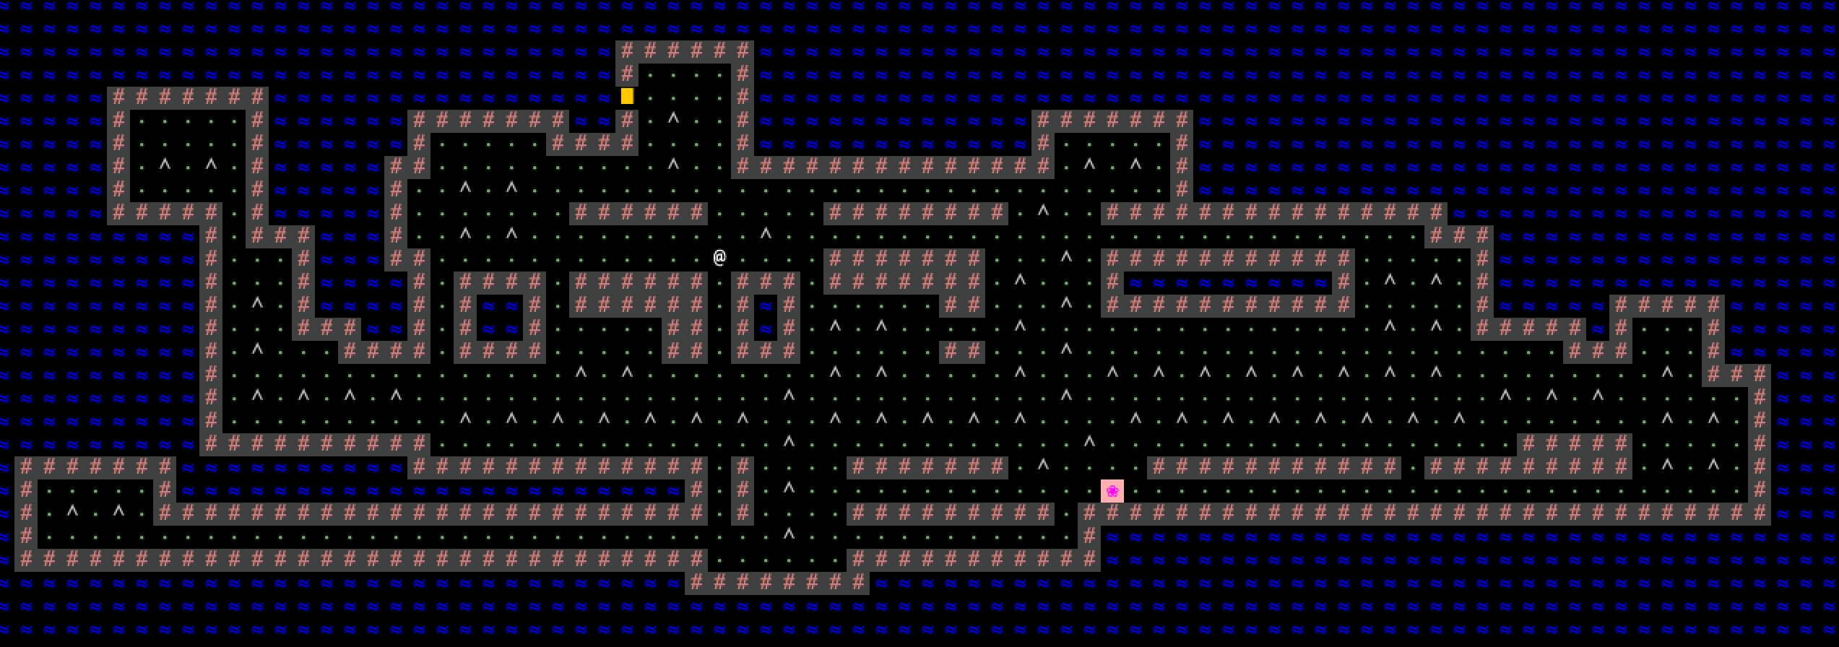
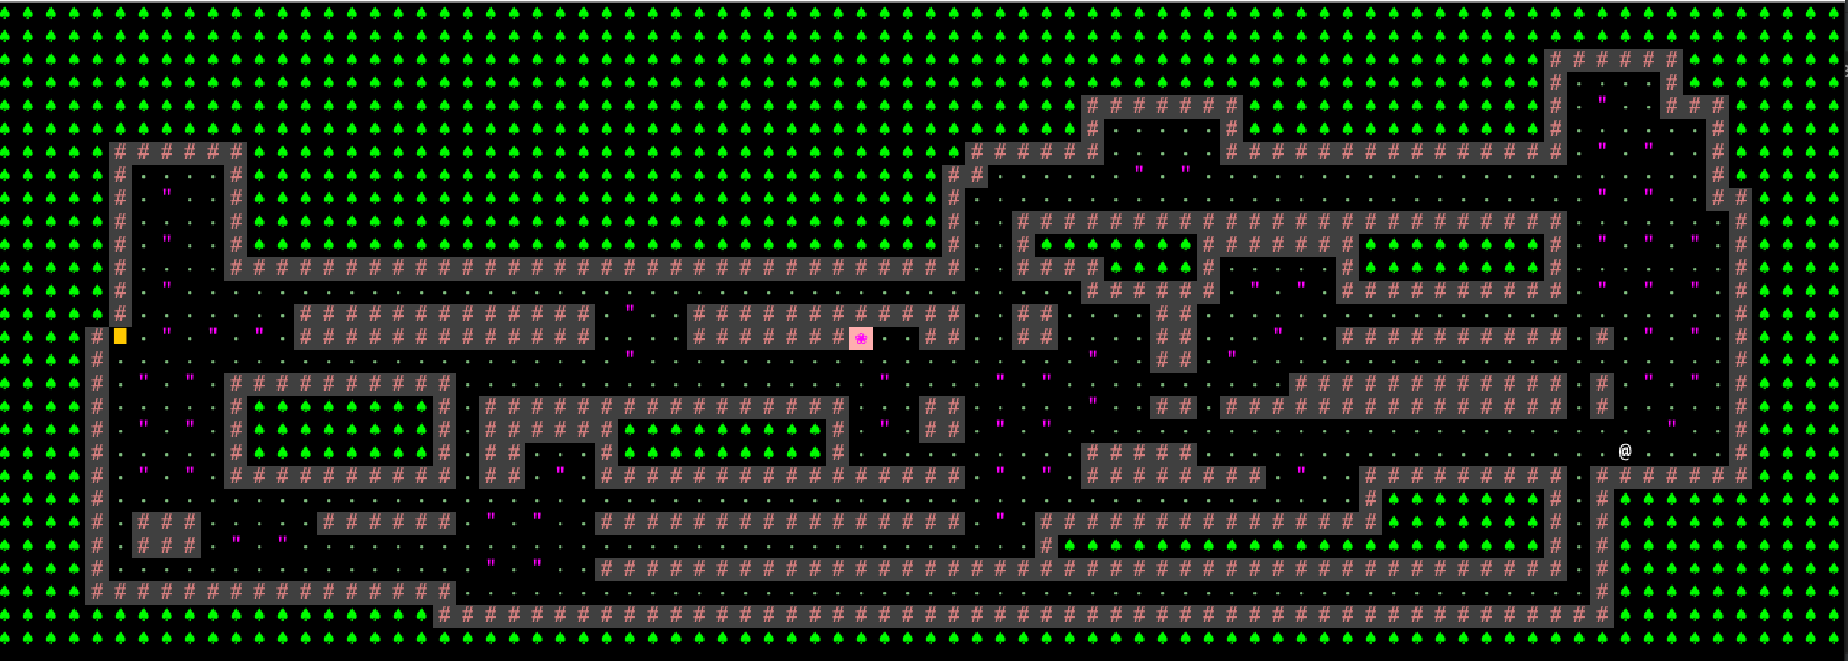
Creative Mechanics 2: Atlantis & Amazon
There are 2 levels to complete your quest: Lost City of Atlantis (Level 1) and the Depths of the Amazon (Level 2)

Slide 4
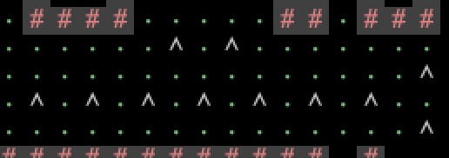
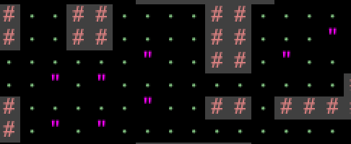
Creative Mechanics 3: Poisonous Spikes & Venomous Grass
At each level, depending on the map, there are different tiles. When stepped on, you LOSE!

Slide 5


Bonus Creative Mechanics – Flavor text

Slide 6
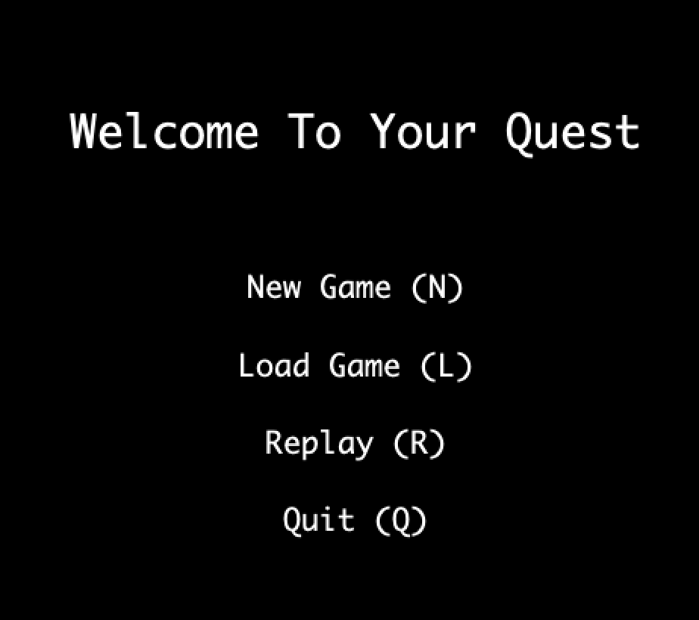
Bonus Creative Mechanics – Replay
You can replay your moves!

Slide 7
Welcome to your Quest
Let’s get started in Atlantis

